Slide 1
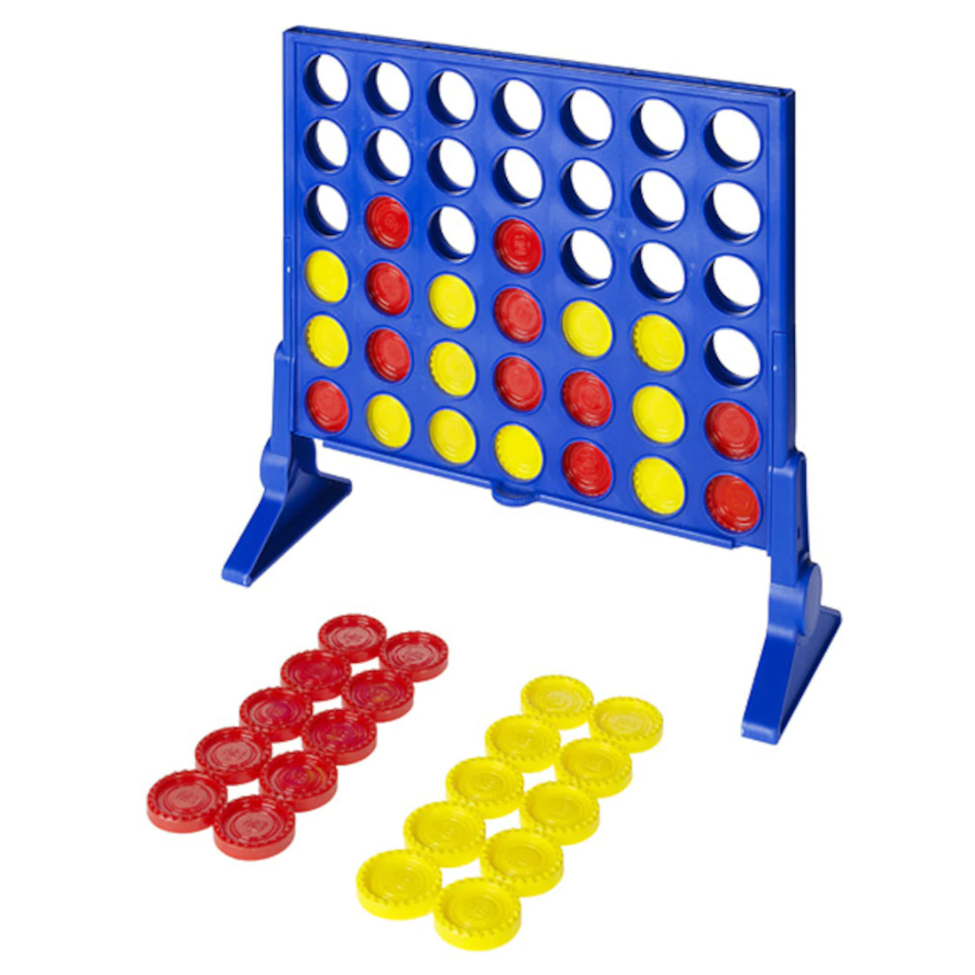
Connect Four
What Connect Four is and how it is played
How we plan on implementing our version of Connect 4 using Python.
Some of the larger components in the game and why they are important.
Some difficulties we expect to encounter and how we are planning to tackle them.

Slide 2
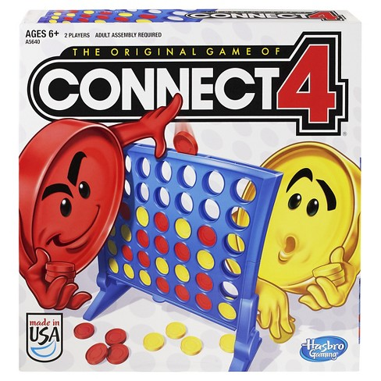
What is Connect Four
Connect 4 is a fairly simple game in which 2 players alternate dropping their own coloured discs into a 7x6 board – from the top.
Each player is trying to claim victory by connecting 4 of their pieces, either vertically, horizontally, or diagonally, before the other player can do the same.

